Slide 1
TrackSide/Car Software
By Lawrence Benitez, Leo Dai, Aiden McDougald, Evan Steinhoff, Connor Ryan-Peterson

Slide 2
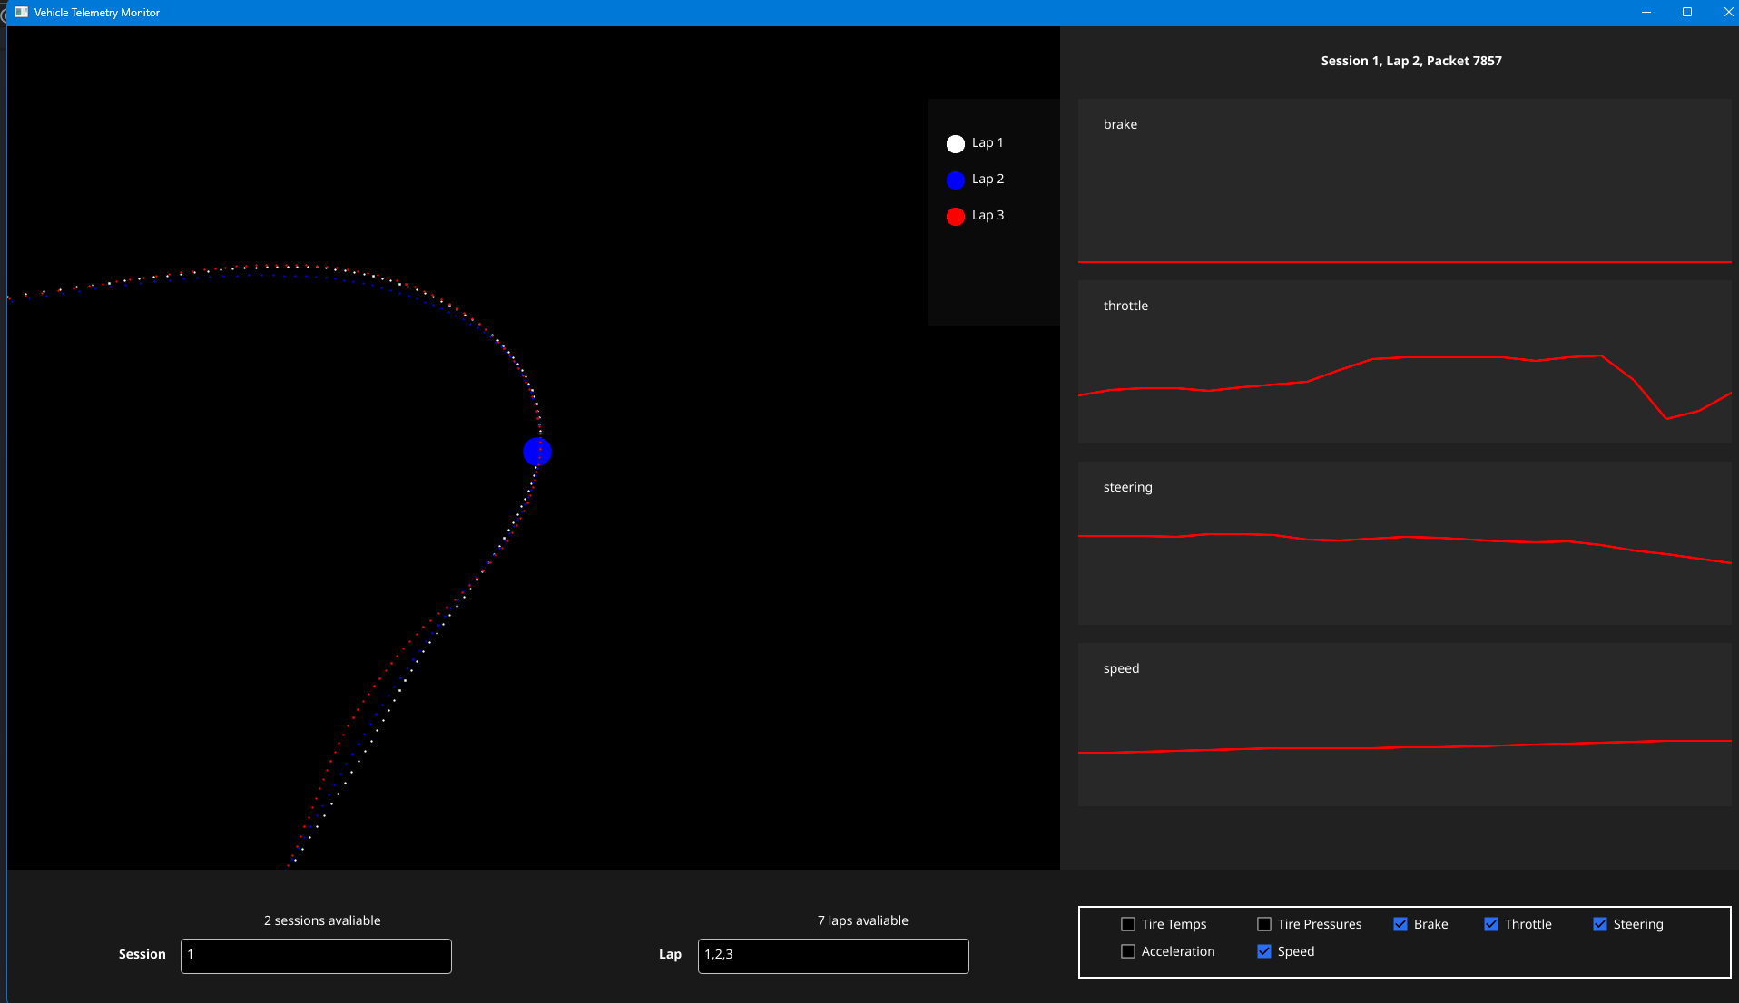
What We Have Done So Far
We created Trackside, a software to be able to track systems on the car in real time. This software also allows you to go back in past laps to monitor car behavior allowing users to spot errors or gather insights.

Slide 3
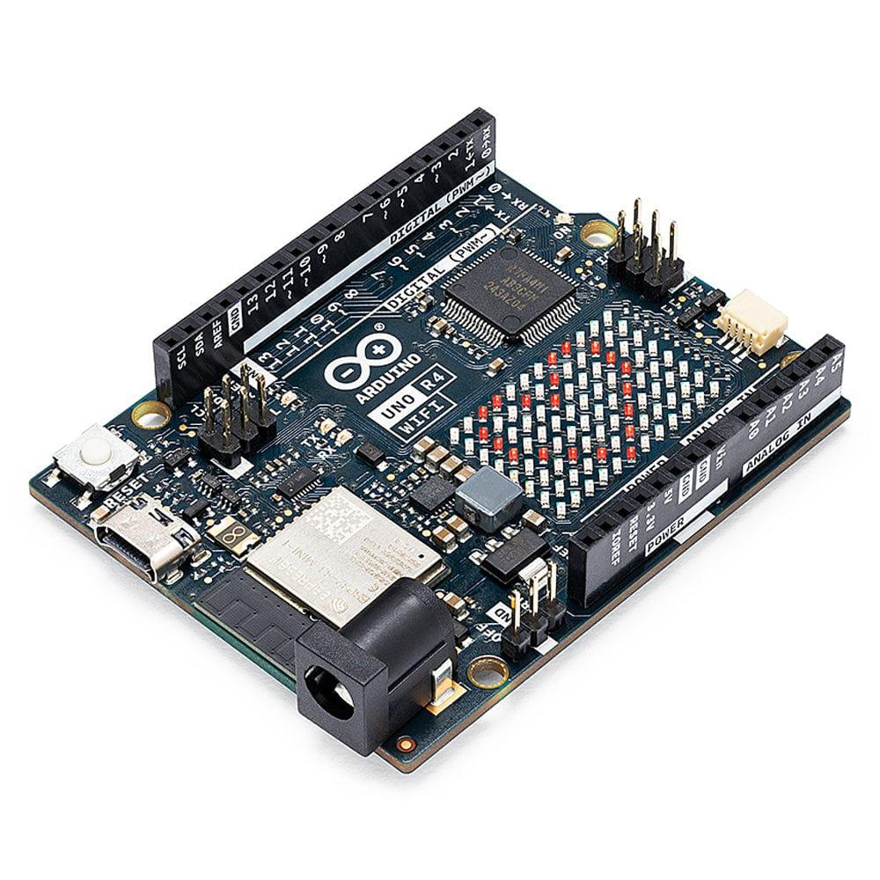
What We Are Going To Do Next
Improve TrackSide App
Add more style and organization to UI
Convert from Go to Unity
Write the overall software needed for the car
This include software for the central raspberry pi controlling the motors and also software for the various components in the car.
Integrate both pieces of software with each other
Aka making sure the TrackSide app can see data from the car in real time.

Slide 4
Intended Audience
Our project is intended for the Formula Racing Club, making software for the car and the tracking data interpretable for those trackside.
However, TrackSide can be integrated with and used for any sort of telemetry monitoring.

Slide 5

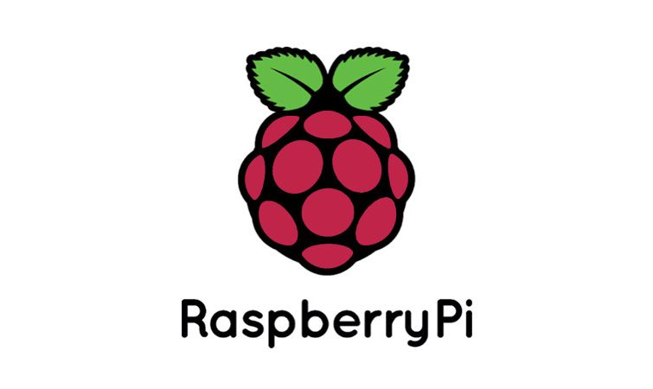



What Technologies We Are Gonna Use

Slide 6
Thank you for listening!
Questions?

